Slide 1

Wixor: Dynamic TDD Policy Adaptation for 5G/xG Networks
Ahmad Hassan, Shivang Aggarwal, Mohamed Ibrahim, Puneet Sharma, Feng Qian
December 11, 2024
Notes:
Hi everyone! My name is Ahmad Hassan, and in this project we come up with a new way to dynamically configure 5G TDD policy.

Slide 2





Frequency Division Duplex
(FDD)
Time Division Duplex
(TDD)
uplink
uplink
downlink
uplink
downlink
downlink
Frequency
Frequency
Time
Time
Notes:
In mobile networks, we have two ways to mange how the data is transmitted and received over the same frequency band.
FDD uses separate frequencies for uplink and downlink transmission.
While TDD uses the same frequency but allocates different time slots for sending and receiving data.

Slide 3


TDD Pattern
…
Slot
D
D
D
S
U
D
D
D
S
U
D
D
D
S
U
D
D
D
S
U
Symbols
D
D
D
D
D
D
D
D
D
D
D
D
D
D
D
D
D
D
D
D
D
G
G
G
U
U
U
U
U
U
U
U
U
U
U
U
U
U
U
U
U
U
TDD policy: arrangement of slots and symbols in a TDD pattern
Find the best TDD policy given our objectives!
Notes:
Each time slot can either be downlink that contains all downlink symbols, uplink, or special that contains a mix of uplink, downlink and guard period symbols.
These slots are repeated in time and called a TDD Pattern.
The arrangement of uplink, downlink and guard slot and symbols is called a TDD policy.
In this work, our goal was to find the best TDD policy given our objectives which we will discuss soon!

Slide 4

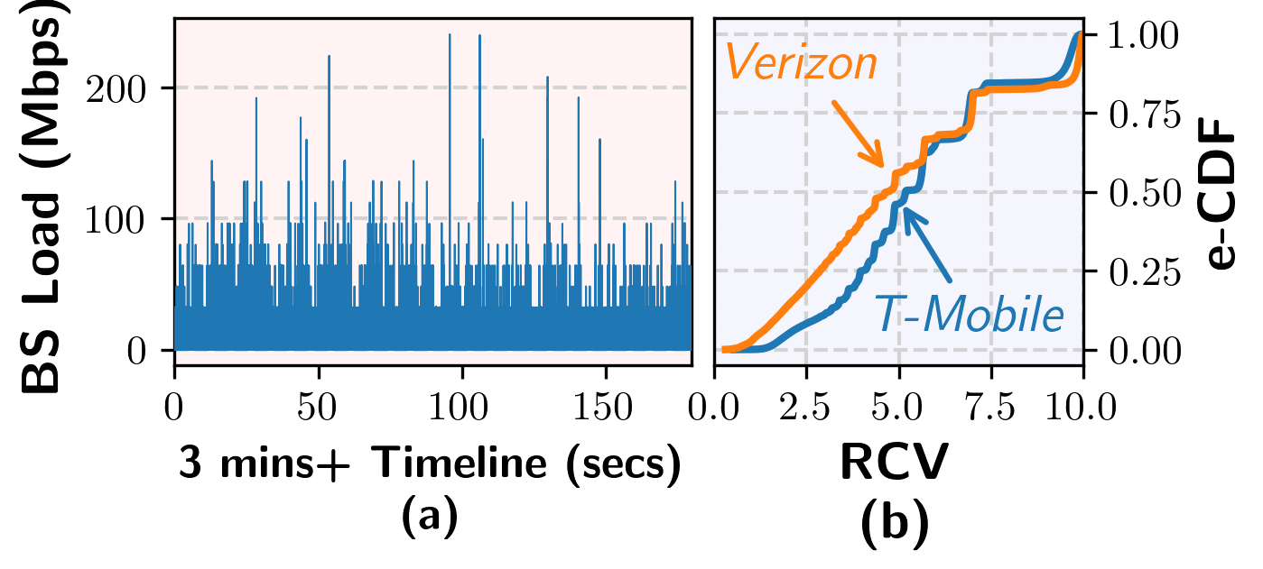



What’s the problem with existing TDD policies
Static TDD policies used by operators are incapable of adapting to traffic load fluctuations!
Downlink-heavy TDD policies used by operators cannot handle emerging 5G applications!
Augmented and
Mixed Reality
Remote monitoring and surgery
source: 3rockar
source: news-medical.net
Notes:
SO now the next question is: what’s wrong with the exiting TDD policies.
First of all, the BS traffic load changes frequently in the real world as shown in this plot.
For our whole dataset, the traffic load changes almost 5 std. dev. compared to the running average every single sec.
This means that the static policies cannot adapt to traffic fluctuations.

Slide 5


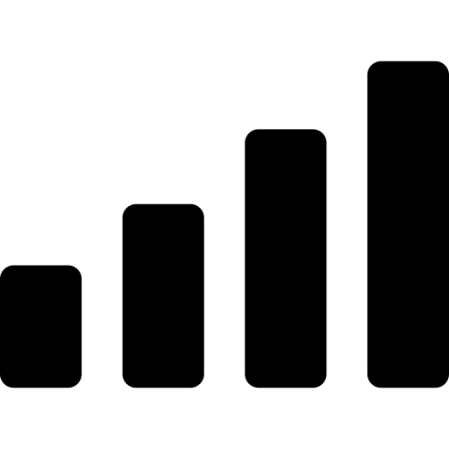
What can we do to solve this problem
Static TDD policies are incapable of adapting to traffic load fluctuations!
Downlink-heavy TDD policies cannot handle emerging 5G applications!
Make the TDD policy dynamic and proactive!
Private 5G
Notes:
So, the question is: what can be done to solve all these issues?
And we argue that we should make TDD policy adaptation dynamic and proactive.
Now, 3GPP defines the procedure to do dynamic TDD policy adaptation but the actual algorithm is left open.
And TDD policy adaptation will become even more important for private 5G deployments where we have programmability of the radio access network.

Slide 6

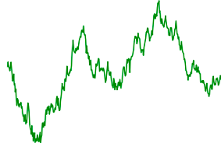



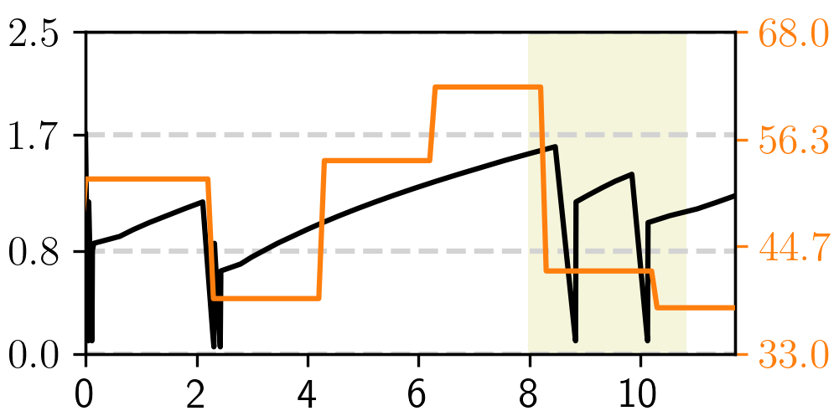
But what makes the problem challenging
1000s of valid slot and symbol arrangements!
Scalability
D
D
D
D
G
G
U
U
U
D
D
BS Load
Signal Strength
Dynamic radio environment
Asymmetric UL & DL
CWND
% of UL slots
Interference with rate adaptation modules
Timeline (secs)
Notes:
Now you might ask: what makes this problem challenging and difficult to solve?
So first of all, we run into a scalability challenge. For example, the number of possible slot and symbol arrangements that can be configured every millisecond are in 1000s. Then, we have 10s and 100s of users attached to the BS.
Similarly, the radio environment is highly dynamic. For example, the BS load fluctuates frequently as seen before, we have diverse application requirements, and the channel conditions fluctuate too.
Other than that, the downlink and uplink is asymmetric so assigning same number of resources for both doesn’t translate to similar performance.
And finally, we saw that frequent or drastic changes in TDD policy can interfere with the transport and application layer rate adaptation modules.

Slide 7

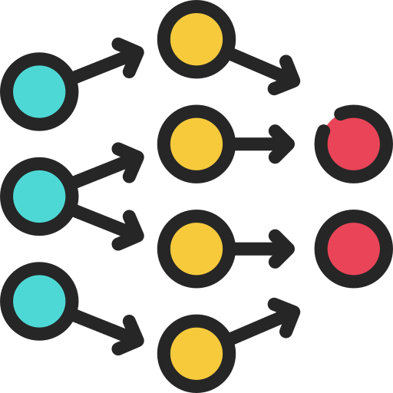
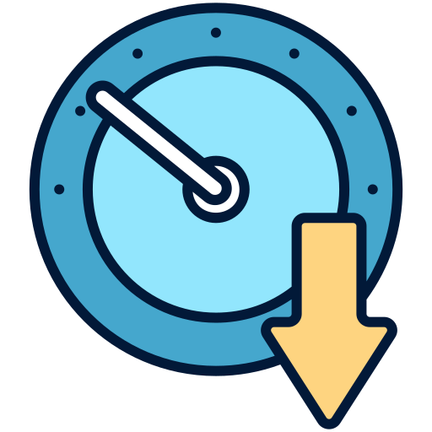
TDD Policy Adaptation with
Wixor
Scalability
Break down the problem in two steps
Dynamic radio environment
Use reinforcement learning to handle environment dynamics
Asymmetric UL & DL
Be conservative in TDD policy adaptation
Interference with rate adaptation modules
Notes:
So to address all these challenges, we introduce Wixor.
Since directly searching for the best TDD pattern is computationally expensive, we break down the problem into two steps that helps us address the scalability issue.
Then, we use reinforcement learning to handle dynamic radio environment and asymmetric uplink and downlink, and to generalize under unseen conditions.
And finally, we try to be conservative when changing the TDD policy to avoid interference with rate adaptation modules.

Slide 8



TDD Policy Adaptation with
Wixor
Notes:
So now let’s look at how our system works in the real world.
First, in a typical scenario, we have a base station and a few mobile devices and they are communicating over the air.
Each mobile device has an uplink buffer, while the BS manages downlink buffers of all devices separately.
Wixor runs on the base station to perform dynamic TDD policy adaptation.

Slide 9


TDD Policy Adaptation with
Wixor
Features
Demand
Customization
Traffic Demand
uplink
equal
downlink
D
D
U
D
U
BS Load
TDD Policy
Channel Quality
Policy
Provision
D
D
U
D
U
TDD Policy
QoS Requirements
Notes:
So let’s now dive a bit deeper and see how Wixor solves the problem.
So let’s say we have some features or inputs. These can be … and we have to decide the TDD policy based on that. But, as we discussed, Wixor does not directly compute the TDD policy. It breaks down the problem.
First, it finds the % of resources we need for uplink versus downlink. This is called demand customization.
Then, based on the percentage, it finds the best arrangement of uplink and downlink slots. This reduces the number of arrangements Wixor has to explore. We call this process policy provisioning.

Slide 10
TDD Policy Adaptation with
Wixor
Proactive Demand
Customization Engine
Smart Policy
Provision Framework
Notes:
Just to summarize the last slide, Wixor has a proactive demand customization engine, and a smart policy provision framework. Now, let’s see how each component works in detail.

Slide 11
1st Step: Demand Customization
Features
Percentage (%) of
uplink resources
Traffic Demand
uplink
equal
downlink
BS Load
Action
Agent
Environment
Channel Quality
Reward
BS-level
Feature Engineering
RL-based
Resource Forecasting
QoS Requirements
Notes:
Since we have features for each UE connected to the base station and we can run into the curse of dimensionality, we do BS-level engineering to come up with a fixed number of inputs for the reinforcement model.
Then, this input state is fed into an RL-based resource forecasting framework that outputs the % of uplink resources we need at any given moment in time. Downlink resources are simply overall minus uplink resources and guard periods. More details of the RL framework can be found in our paper.

Slide 12

TDD Policy Adaptation with
Wixor
Proactive Demand
Customization Engine
Smart Policy
Provision Framework
BS-level
Feature Engineering
Context-aware
Resource Forecasting
Notes:
Again to summarize the last slide, we have BS-level feature engineering and context-aware resource forecasting modules inside the demand customization engine.

Slide 13
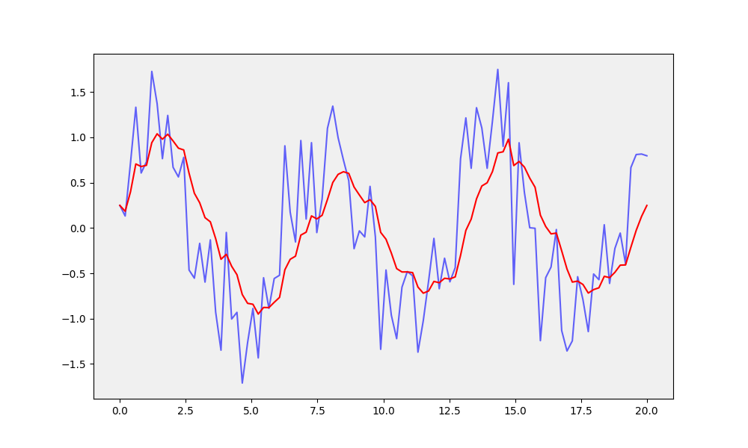


2nd Step: Policy Provision
Percentage (%) of
uplink resources
CWND
% of UL slots
uplink
equal
downlink
Timeline (secs)
Conservative Policy Smoothing
D
D
D
D
G
G
U
U
U
D
D
Inter-slot Delay
Guard Period Overhead
QoS-aware Policy Provision
Notes:
Now, once we know the ratio of uplink and downlink resources needed, we need to find the exact arrangement of uplink and downlink slots and symbols.
To do that, our policy provisioning framework performs two steps.
First, as you can remember from the challenges slide that frequent and drastic changes in TDD policy can interfere with rate adaptation modules, we smooth out the percentage of predicted uplink resources using a filter.
Then, using this updated number, we find the exact arrangement of slots and symbols. But, finding this arrangement is not straightforward. So, if we have a TDD pattern, we call the time interval between consecutive slots of same type inter-slot delay. Now, if you want to reduce this inter-slot delay or network latency, you should alternate between downlink and uplink slots. But that would increase the guard period overhead since a guard period is needed between downlink and uplink. But guard period reduces the effective data rate of the base station. This means there’s an inherent tradeoff between inter-slot delay and guard period overhead or tradeoff between network throughput and latency. So, Wixor balances this latency vs. throughput tradeoff based on the QoS requirements of the users.

Slide 14
TDD Policy Adaptation with
Wixor
Proactive Demand
Customization Engine
Smart Policy
Provision Framework
BS-level
Feature Engineering
Conservative
Policy Smoothing
Context-aware
Resource Forecasting
QoS-aware TDD
Policy Derivation
D
D
U
D
U
Notes:
Now, to put everything together, the policy provisioning framework first does a conservative policy smoothing, and then finds the best arrangement of slots and symbols while being QoS-aware.

Slide 15










Evaluation Setup
Application
Server
Open5GS Core
SRSRAN
GNB
Static-Default
Static-Fair
UEs
Baselines
SDR
Reactive
DRP*
Over-the-air 5G Testbed
Edge-assisted Vehicle Perception
Edge Video Analytics
Live Video Streaming
Trace-driven Simulations
Video On-demand
Video Conferencing
File Download
*On using Deep Reinforcement Learning to dynamically derive 5G New Radio TDD pattern. In 2021 IEEE Global Communications Conference (GLOBECOM).
Notes:
To evaluate Wixor, we use two setups.
The first one is an over-the-air testbed setup based off of B210 SDRs which are running SRSRAN, pixel devices, 5g core and application server.
The second setup consists of large-scale trace-driven simulations. We wrote the simulator with ns3 and its 5g-lena module.
To compare Wixor with existing approaches, we implement 4 baselines. Static default is the default static TDD policies used by current 5g operators. Static fair policy looks at the average uplink and downlink load during an experiment and assigns TDD policy based on the ratio of uplink and downlink load. The reactive approach looks at the instantaneous uplink and downlink load and assigns resources based on that. Finally, DRP is a simple reinforcement learning algorithm that uses buffer occupancy and buffer overflow to decide the TDD policy.
Finally, we have six diverse applications including video analytics, live streaming, video on-demand streaming etc.

Slide 16
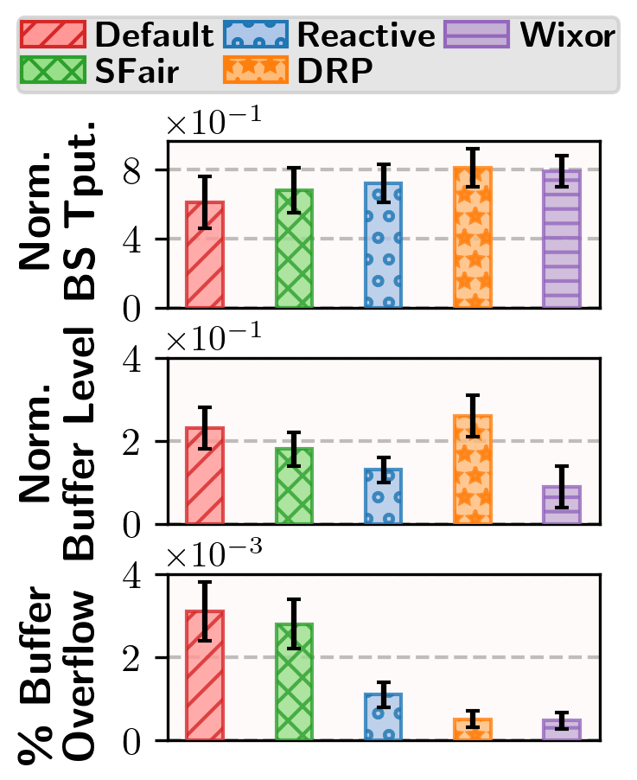



Static
Default
Static
Fair
Reactive
DRP
Wixor
QoS Improvement
↓ 84%
6 apps with 10 instances
Buffer Overflow (%)
5 mins runtime
Start times → Poisson Process
↓ 65%
Wixor’s Objectives
Normalized Buffer Level
Network Throughput
Network Latency
Loss Rate
Normalized BS Throughput
Wixor effectively improves 5G QoS!
↑ 30%
Notes:
So first, I’d show you Wixor’s QoS improvement. Let’s quickly look at the experiment setup. So here, we use simulations with all 6 diverse apps, where each app has 10 instances. Each instance runs for 5 mins and starts according to a Poisson process.
So before, we look at the results, let’s quickly check out Wixor’s 3 RL objectives. It tries to improve network throughput by increasing the normalized BS throughput. It also tries to reduce the network latency by minimizing the amount of data in the buffers. Finally, it reduces loss rate by making sure there are no packet losses.
As you can see, it reduces buffer overflow …
It improves throughput up to x% ..
Overall, Wixor is highly effective in improving the 5G quality of service metrics.

Slide 17
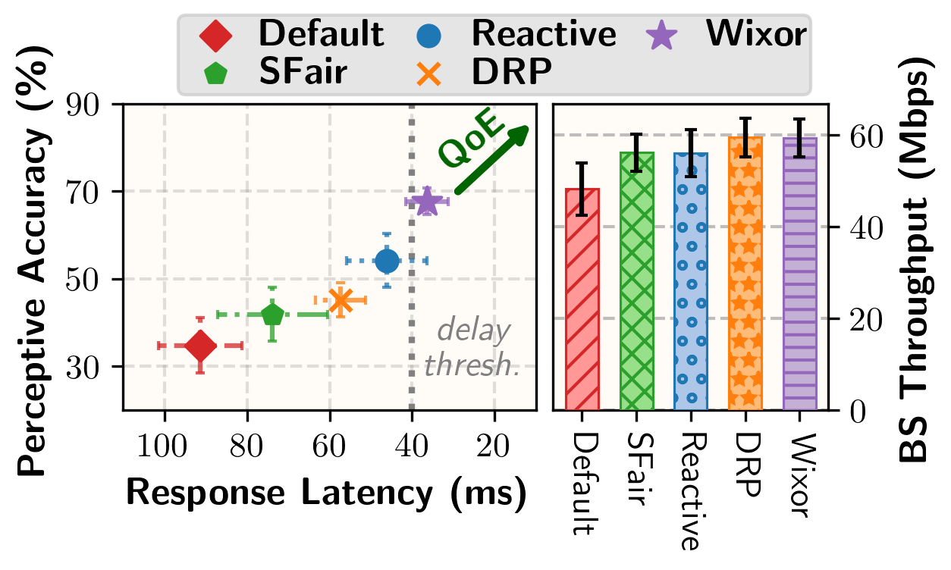
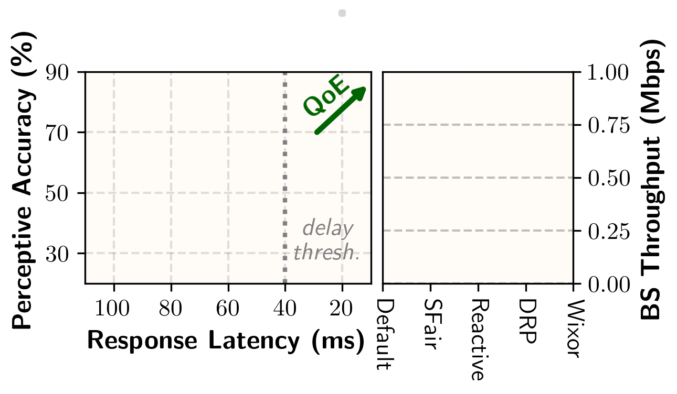
App QoE Gains
Over-the-air testbed
Edge Video Analytics Application
Trace-generated background traffic
Wixor significantly boosts Edge Video Analytics QoE!
← 21%
25% ↑
Check out our paper for more results!!
Notes:
Now, let’s see how that QoS improvement translate to QoE gains.
So here we have an over-the-air testbed setup where we are running an edge video analytics application which consists of an Object Detection task
We also generate background traffic to make sure that the load is between X-Y%.
We use the frame response latency and perceptive accuracy as performance metrics. The perceptive accuracy captures mean average precision for sending frames and replaces a frame’s inference with the last feedback if a response is not received within 40 ms.

Slide 18



Wixor: Dynamic TDD Policy Adaptation for 5G/xG Networks
It is an important/challenging problem and existing schemes perform poorly
We design and prototype Wixor that performs dynamic TDD policy adaptation for 5G/xG networks
Wixor offers significant gains for apps, works well under diverse conditions, and has a low overhead
Reach out at ahmadhas@usc.edu if there are any questions.

Slide 19




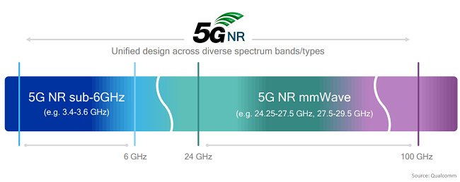
Why is TDD becoming more popular
>80% operators are using TDD
Key 5G bands are TDD
Flexible radio resource allocation
uplink
equal
downlink
Notes:
80% of the operators are using TDD
The bands in FR2 (MidBand and mmWave) and c-band are TDD
TDD allows for more flexible spectrum allocation, as it enables dynamic adjustment of the ratio between uplink and downlink transmission
TDD can achieve lower latency compared to FDD because it allows for faster switching between uplink and downlink transmissions

Slide 20
How is scheduling done in 5G TDD
10 ms
…
Frame
0
1
2

Slide 21
How is scheduling done in 5G TDD
10 ms
…
Frame
0
1 ms
…
Subframe
0
1
2
3
4
5
6
7
8
9
0.5 ms
…
Slot
0
1
0
1
0
1
0
1
0
1
0
1
0
1
0
1
0
1
0
1
0
1
TDD Pattern
D
D
D
S
U
D
D
D
S
U
D
D
D
S
U
D
D
D
S
U

Slide 22
How is scheduling done in 5G TDD
…
Frame
0
…
Subframe
0
1
2
3
4
5
6
7
8
9
…
Slot
0
1
0
1
0
1
0
1
0
1
0
1
0
1
0
1
0
1
0
1
0
1
TDD Pattern
D
D
D
S
U
D
D
D
S
U
D
D
D
S
U
D
D
D
S
U
Symbols
D
D
D
D
D
D
D
D
D
D
D
D
D
D
D
D
D
D
D
D
D
G
G
G
U
U
U
U
U
U
U
U
U
U
U
U
U
U
U
U
U
U

Slide 23
…
Slot
0
1
0
1
0
1
0
1
0
1
0
1
0
1
0
1
0
1
0
1
0
1
TDD Pattern
D
D
D
S
U
D
D
D
S
U
D
D
D
S
U
D
D
D
S
U
Symbols
D
D
D
D
D
D
D
D
D
D
D
D
D
D
D
D
D
D
D
D
D
G
G
G
U
U
U
U
U
U
U
U
U
U
U
U
U
U
U
U
U
U
TDD policy: arrangement of slots and symbols in a TDD pattern
Find the best TDD policy given our objectives!

Slide 24

What are existing TDD policies like
Operator | Downlink Resources | Uplink Resources
74.2%
22.8%
72.8%
22.8%
74.2%
22.8%
Current 5G TDD policies are static and downlink-heavy!
Notes:
But before we discuss the details, the question is what are the TDD policies like today?
To answer this question, we conducted a study with 3 large US 5G operators and here we present the % of resources they allocate for downlink vs. uplink.
As you can see, all operators have static and downlink-heavy TDD policies.

Slide 25
What’s the problem with existing TDD policies
Traffic load changes can be ~5x of the running average
Static TDD policies are incapable of adapting to traffic load fluctuations!
Notes:
SO now the next question is: what’s wrong with the exiting TDD policies.
First of all, the BS traffic load changes frequently in the real world as shown in this plot.
For our whole dataset, the traffic load changes almost 5 std. dev. compared to the running average every single sec.
This means that the static policies cannot adapt to traffic fluctuations.

Slide 26
What’s the problem with existing TDD policies
Compared to traditional mobile apps, emerging 5G/xG apps are more uplink-intensive
Augmented and
Mixed Reality
Downlink-heavy TDD policies cannot handle emerging 5G applications!
source: 3rockar
Remote monitoring and surgery
Uplink load was higher than downlink load ~4% of the time in our experiments
source: news-medical.net
Notes:
The second problem is that we now have emerging applications that are uplink-intensive. For example, AR/MR, remote surgery.
Therefore, the downlink-heavy TDD policies cannot handle emerging applications.
In our experiments, we found that uplink load was higher than the downlink load almost 4% of the times and this number will likely increase in future.

Slide 27


What are some naive solutions
1
Static-Default
Emerging uplink-intensive apps
2
Static-Fair
Changing network loads
3
Reactive
Farseeing decisions
Make TDD policy adaptation proactive!
Notes:
Already discussed that static policies do not work.
Even when the static policies are fair, they cannot adapt to changing load.
A straightforward solution is to run a reactive scheme (describe what it means). It performs better than static policies, but still nowhere close to the best possible (show result from eval).

Slide 28
TDD Policy Adaptation
D
D
U
D
U
TDD Policy
Uplink Buffers
Downlink Buffers

